Slide 1
Code Like a Snake Charmer
Introduction to Python!
Dr. Je’Anna Abbott, Professor
Jamey Johnston, Sr. Data Scientist

Slide 3

Dr. Je’Anna Abbott
University of Houston
Education
Texas A&M - MS in Analytics
U. of Houston - PhD
U. of Houston – JD
U. of Chicago – MBA
Spec’s Charitable Foundation Professor
/jeannaabbott
@STATWonderWoman

Slide 4

Jamey Johnston
Project Coach Texas A&M Analytics
Education
Texas A&M - MS in Analytics
LSU - BS in Spatial Analysis
Semi-Pro Photographer
Sr. Data Scientist
http://jamey.photos
Blog
http://STATCowboy.com
/jameyj
@STATCowboy
Code
https://github.com/STATCowboy/SnakeCharmer-Intro

Slide 5

Agenda
Introduction to Python
Anaconda / IDEs
Comments, Numbers and Strings
Lists, Tuples and Dictionaries
Pandas
Control Flows
Functions
Packages
Python and Microsoft
Demos
Source: https://www.python.org/community/logos/

Slide 6

Introduction to Python
Why Python?
Expansive Open Source Library of Data Science Tools (Giant Ecosystem)
Easy language for new programmers
Microsoft Support in tools like Azure Machine Learning, SQL Server 2017, Microsoft Machine Learning Server
You can code on a Raspberry Pi (Who doesn’t like Pi!)
One of the most popular program languages (IEEE/GitHub ranked Python #3 in 2016)
Interpreted language, saves you time, no compilation and linking is necessary

Slide 7

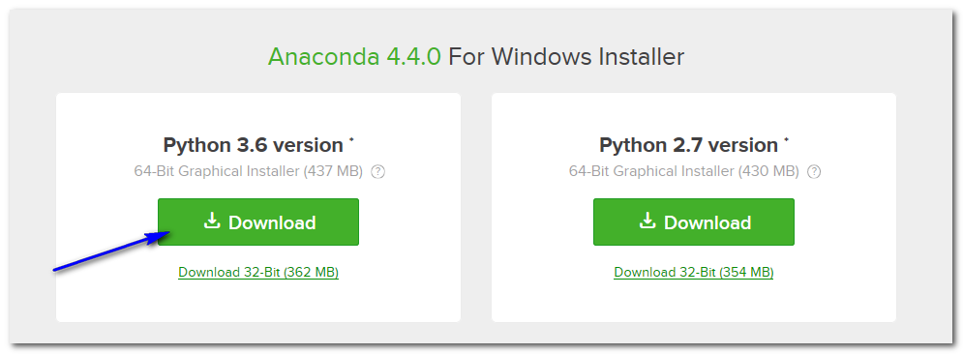
Anaconda
Source: http://www.anaconda.com
Anaconda
https://www.anaconda.com/download/
Download the 64-bit Python 3.6 version (still can setup Python 2.7 environments)

Slide 8
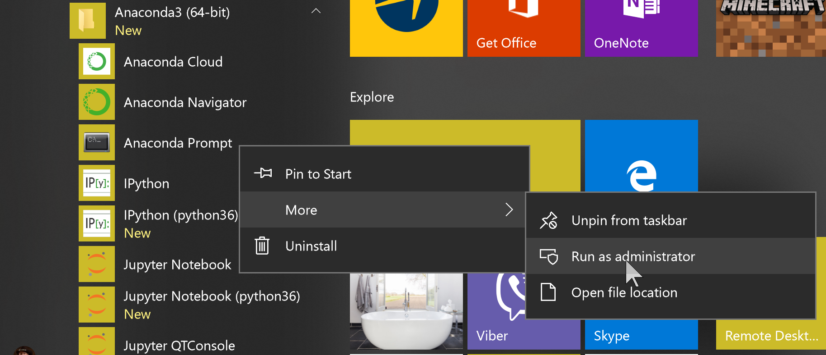
Anaconda
Conda
Open Source Package Management System and Environment Management System
Launch the “Anaconda Prompt” as Administrator to Manage Anaconda Environment

Slide 9
Anaconda
Conda Commands
Upgrade All Packages
conda update --all
Setup New Environment (e.g. Python 3.6)
conda create --name python36 python=3.6
activate python36
Install Packages (few examples below)
conda install seaborn
conda install spyder
conda install jupyter
Setup a Python 2.7 Environment: Use above steps and change 36 to 27 and 3.6 to 2.7

Slide 10
Anaconda
Conda Commands
List Environments
conda env list
* indicates active environment
List Packages in Environment
conda list
Remove an Environment
conda env remove --name deleteme
Update Package
conda update PACKAGENAME
https://conda.io/docs/_downloads/conda-cheatsheet.pdf

Slide 11
Conda
Demo

Slide 12



Python IDE
PyCharm
https://www.jetbrains.com/pycharm/
Spyder
Included in Anaconda Distribution
Python for Visual Studio
https://www.visualstudio.com/vs/python/

Slide 13
PyCharm
PyCharm Shortcuts
https://www.jetbrains.com/help/pycharm/2016.1/keyboard-shortcuts-you-cannot-miss.html
https://www.jetbrains.com/help/pycharm/keyboard-shortcuts-by-category.html
Run – Alt+Shift+F10
Run Selection / Current Line – Alt+Shift+E
Comment / Uncomment Code – Ctrl+Slash / Ctl+Shift+Slash
Invoke Code Completion – Ctl+Space
Indent / Un-indent (selection of code) – Tab / Ctl+Tab

Slide 14


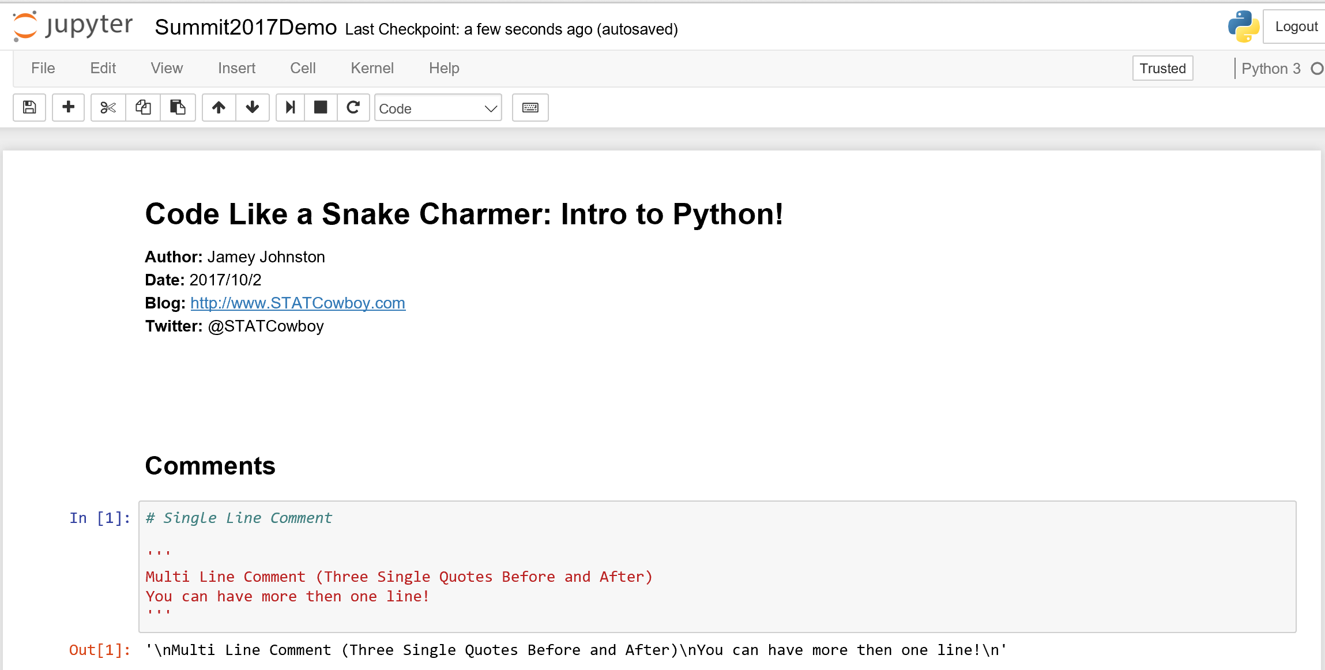
Jupyter Notebooks
Computer Code and Rich Text
http://jupyter-notebook.readthedocs.io/en/latest/
Activate desired environment first
Then to Start a Notebook – jupyter notebook

Slide 15
IDE / Tools
Demo

Slide 16
Comments
Single Line Comment
# - Pound Sign/Hash is used for single line comments
# Single Line Comment
Multi-Line Comment
‘ ‘ ‘- Three single-quotes before and after the comments
'''
Multi Line Comment (Three Single Quotes Before and After)
You can have more then one line!
'''

Slide 17
Numbers
Operators “+, -, * and / “ as you would expect!
taxRate = 8.25 / 100
price = 100
tax = price * taxRate
finalPrice = price + tax
print('Tax: ${:,.2f}'.format(tax))
print('Final Price: ${:,.2f}'.format(finalPrice))
Tax: $8.25
Final Price: $108.25

Slide 18
Strings
single quotes ('...') or double quotes ("...")
simpleString = 'This is a simple string!'
print(simpleString)
simpleStringDouble = “This is a simple string!”
print(simpleStringDouble)
This is a simple string!
This is a simple string!

Slide 19
Strings
Escape with “\”
print('Isn\'t Pass Summit Awesome')
Isn't Pass Summit Awesome

Slide 20
Strings
Span String Literals Multiple Lines
print("""\
Usage: magicSummitPass [OPTIONS]
-h Display this usage message
-S year Magically get me into Summit that year for free!
""")

Slide 21
Strings
Repeat Strings with "*" and Concatenate with "+"
espn = 3*'duh '+' (we still wish MJ was playing!) '+3*'duh '
print(espn)
duh duh duh (we still wish MJ was playing!) duh duh duh

Slide 22
Strings
Slicing/Indices on Strings
Positive indexes start at 0 and Negative start with -1
passSummit = 'PASS Summit 2017'
+---+---+---+---+---+---+---+---+---+---+---+---+---+---+---+---+
| P | A | S | S | | S | u | m | m | i | t | | 2 | 0 | 1 | 7 |
+---+---+---+---+---+---+---+---+---+---+---+---+---+---+---+---+
0 1 2 3 4 5 6 7 8 9 10 11 12 13 14 15 16
-16 -15 -14 -13 -12 -11 -10 -9 -8 -7 -6 -5 -4 -3 -2 -1

Slide 23
Strings
Important Notes
Strings are Immutable (i.e. you can’t change them)
len() – will return the length of the string

Slide 24
Basics
Demo

Slide 25
Lists
Compound Data Type
Used to group values together.
Comma-separated values/items enclosed by square brackets.
List can contain different types of data but usually they contain the same types.
myList = [1,2,3,4]

Slide 26
Lists
Slice and Index List
myList[0]
myList[-3:] # slicing returns a new list
Concatenate Lists
myNewList = myList + [5,6,7,9]

Slide 27
Lists
List are mutable (you can change them!)
myNewList[7] = 8
Append to a List
myNewList.append(9)

Slide 28
Lists
Replace a slice (even with a different size)
myNewList[2:4] = [1,1]
Length of list
len(myNewList)

Slide 29
Tuples
Number of Values Separated by Commas
t = 'PASS', 'Summit', '2017'
Tuples may be Nested
nt = t, ('is', 'awesome', '!')

Slide 30
Tuples
Tuples are Immutable
t[2] = '2018’ # Will throw an error!

Slide 31
Dictionaries
Unordered key/value pairs
yearBirth = {'jamey': 1974, 'melanie': 1975, 'jeanna': 1989, ‘robyn': 1979}
Delete item in Dictionary
del yearBirth['robyn']

Slide 32
Dictionaries
List Keys (unordered)
list(yearBirth.keys())
List Keys (sorted/ordered)
sorted(yearBirth.keys())

Slide 33

Pandas
Series and DataFrame
Labeled Array Data Structures
Input/output Tools (CSV, Excel, ODBC)
http://pandas.pydata.org/pandas-docs/stable/10min.html

Slide 34
Pandas
DataFrame
Import Pandas and Read CSV
import pandas as pd
baseball = pd.read_csv('baseball.csv', sep=',', encoding='UTF-8')
Print header of pandas DataFrame
baseball.head()
Print tail of pandas DataFrame
baseball.tail(3)

Slide 35
Pandas
DataFrame
Describe DataFrame
baseball.describe()
Sort by Column
baseball.sort_values(by='Attendance')
Select one Column
baseball[['Team']]

Slide 36
Pandas
DataFrame
Group By
baseballMean = baseball.groupby('Team').mean()
print(baseballMean.sort_values(by='Attendance')[['Attendance’]])
Attendance
Team
Royals 17597.812500
Phillies 20484.825000
Reds 23108.587500
Cubs 34575.037037

Slide 37
Data Structure
Demo

Slide 38
Control Flows
Indention
Indention is used to indicate the scope of a block of code (like { … } in other languages)
Blank lines do not affect indention, Same as Comments on a line by themselves
Word of CAUTION: Turn OFF Tabs!!!
If you copy and paste from the internet you indentions will more than likely be Tabs!
Python cares a great deal about indention! You will get “indention errors” if not right.

Slide 39
Control Flows
Conditionals / Comparisons
PYTHON CODE | RESULT
== | Equal To
!= | Not Equal To
< | Less Than
<= | Less Than or Equal To
> | Greater Than or Equal To
>= | Not Equal To

Slide 40
Control Flows
if … elif … else
n = 5
m = 10
if n < 10 and m < 10:
print('n and m are single digit numbers!')
elif n >= 10 and m < 10:
print('n is a big number and m is a single digit number!')
elif n < 10 and m >= 10:
print('n is a single digit number and m is a big number!')
else:
print('n and m are big number!')

Slide 41
Control Flows
IN Operator on List
if 2 in [1, 2, 3, 4]:
print('Found it!')
else:
print('Keep looking!')

Slide 42
Control Flows
for Loops
for i in [1, 2, 3, 4]:
print(i)
wordList = ['Jamey', 'Melanie', 'Stefanie', 'Robyn']
for word in wordList:
print('Family member name:', word)

Slide 43
Control Flows
Range Function
r = range(5)
print(r)
for num in r:
print(r[num])

Slide 44
Control Flows
Loop over two or more lists
questions = ['name', 'birth year', 'occupation']
answers = ['Jamey Johnston', '1974', 'Data Scientist']
for q, a in zip(questions, answers):
print('What is your {0}? It is {1}.'.format(q, a))

Slide 45
Control Flows
Retrieve Key/Value of List in Loop, Sorted by Key
yearBirth = {'jamey': 1974, 'melanie': 1975, 'jeanna': 1989}
for k, v in sorted(yearBirth.items()):
print(k, 'was born in the year ', v)

Slide 46
Control Flows
break, continue and else
for n in range(2, 10):
for x in range(2, n):
if n % x == 0:
print(n, 'equals', x, '*', n//x)
break
else:
# loop fell through without finding a factor
print(n, 'is a prime number’)
https://docs.python.org/3/tutorial/controlflow.html#break-and-continue-statements-and-else-clauses-on-loops

Slide 47
Control Flows
break and continue … try and except
while True:
txt = input('Enter number (integers only!):')
try:
integer = int(txt)
except:
print('Please enter integer only!')
continue
print('You entered the integer,', integer)
break
print('Done!')

Slide 48
Control Flows
while Loops
num = 0
while num < 10:
print(num)
num = num+1

Slide 49
Functions
Simple Function
# NOTE: non-default parameters must be first!
def greetSummit(year, name=None):
if name is not None:
print('Welcome to PASS Summit ', year, ', ', name, '!', sep='')
else:
print('Welcome to PASS Summit ', year, '!', sep='')
greetSummit(2017)
greetSummit(2017, 'Jamey')

Slide 50
Control Flows
Demo

Slide 51
Packages
pip
PyPA recommended tool for installing Python packages
Some packages are not in the conda repository (e.g. latest tensorflow packages)
pip install --ignore-installed --upgrade tensorflow-gpu
conda
Anaconda Distribution package manager (Use conda if using Anaconda)
conda install pyodbc

Slide 52
Packages
Import Module from Package
Import sys and show Python version/distribution
import sys
sys.version
PYODBC/Pandas Example
import pyodbc
import pandas.io.sql as psql

Slide 53
Packages
Popular Packages
PACKAGE | DETAILS
pandas | High performance, easy use data structures and analysis (DataFrames)
pyodbc | Open Source Python Module for ODBC data sources
matplotlib | 2D Plotting library
scikit-learn | Simple tool for data mining and data analysis / statistics
numpy | N-dimensional arrays, linear algebra, random numbers
SciPy | Math, Stats, Science and Engineering package

Slide 54
Packages
Demo

Slide 55
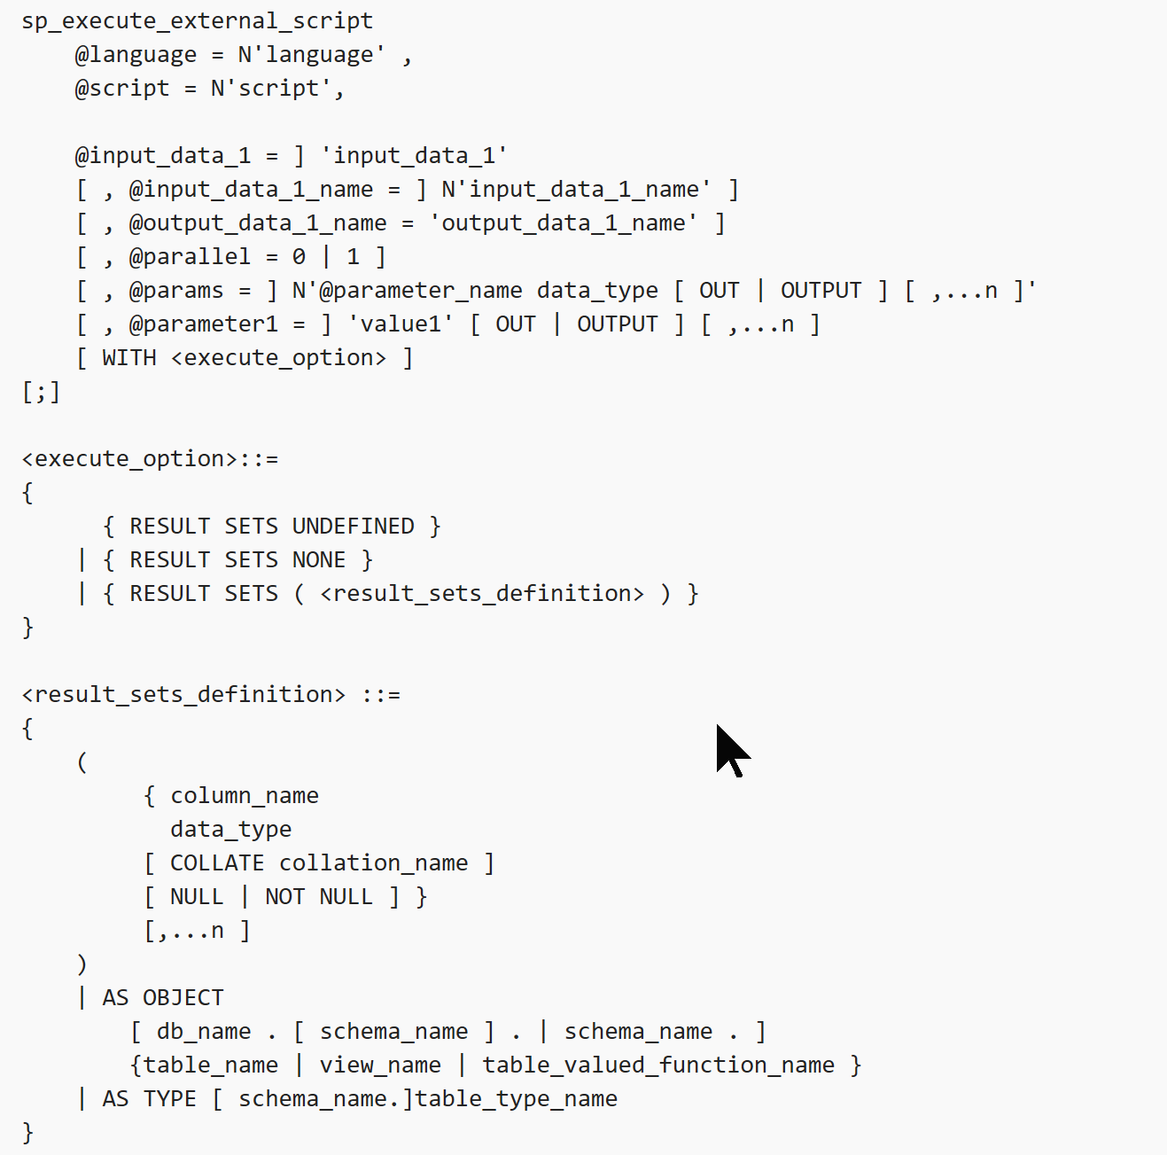
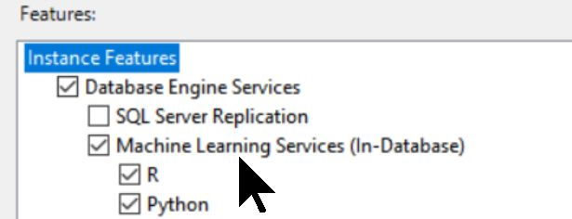
Python and Microsoft SQL Server 2017
sp_execute_external_script
Executes Python via T-SQL in MSSQL 2017
Install Machine Learning Services (In-Database)
Anaconda Distribution installed with MLS
New revoscalepy library – scale and performance
Executes outside the SQL Server process
Data returned as a pandas data frame
Also, supports R

Slide 56
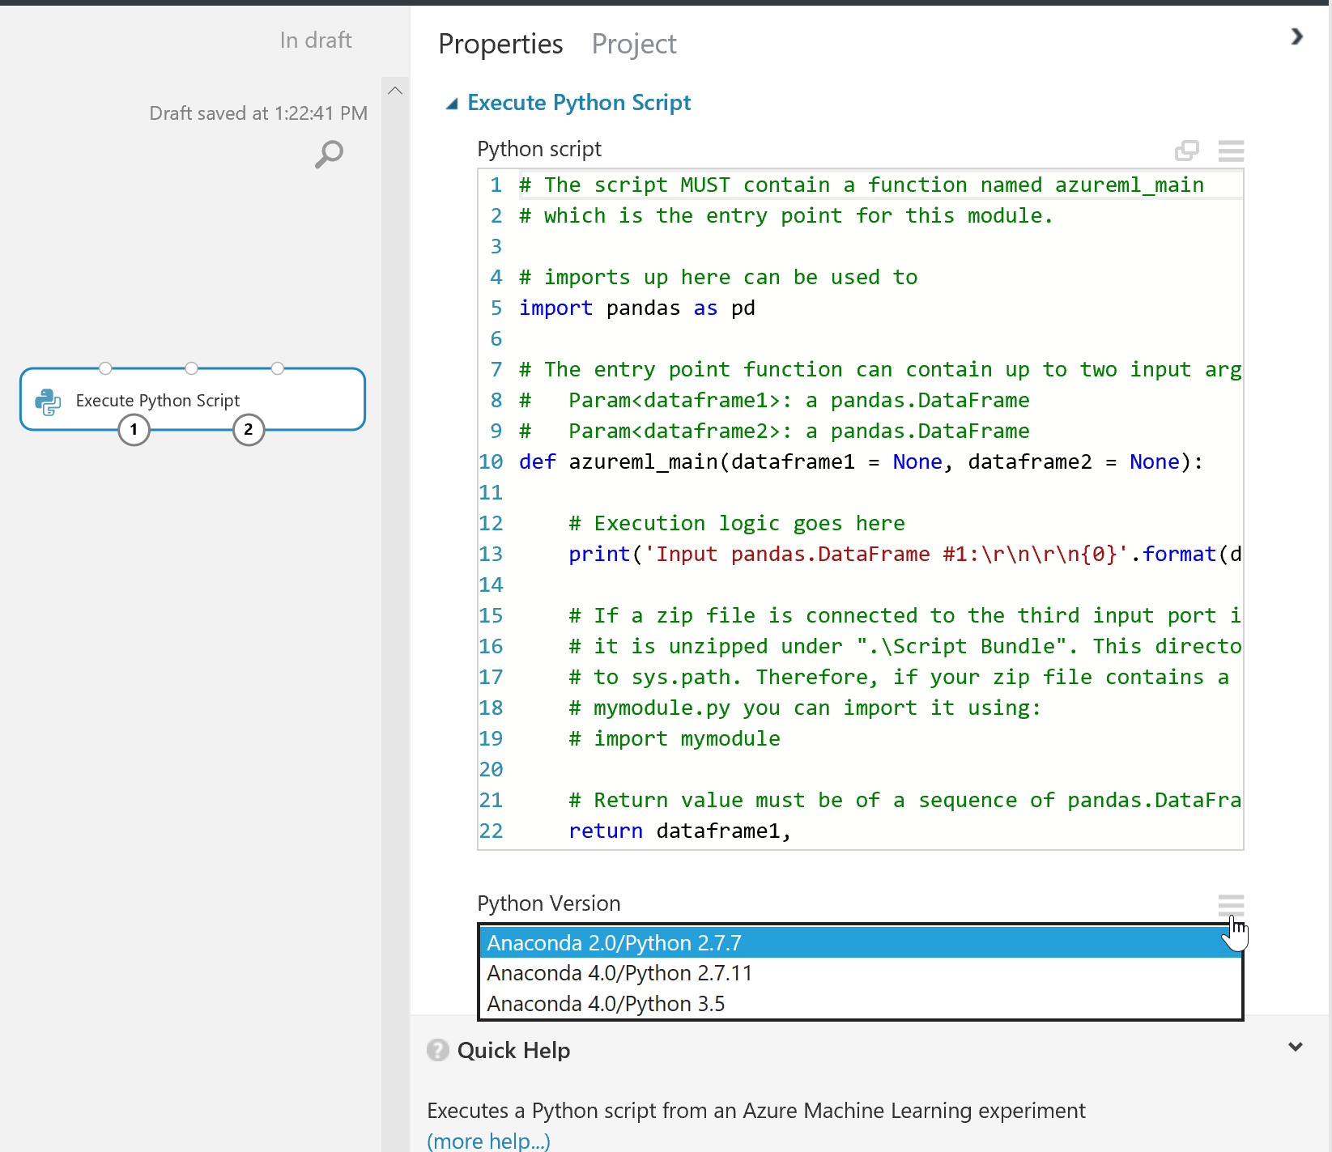
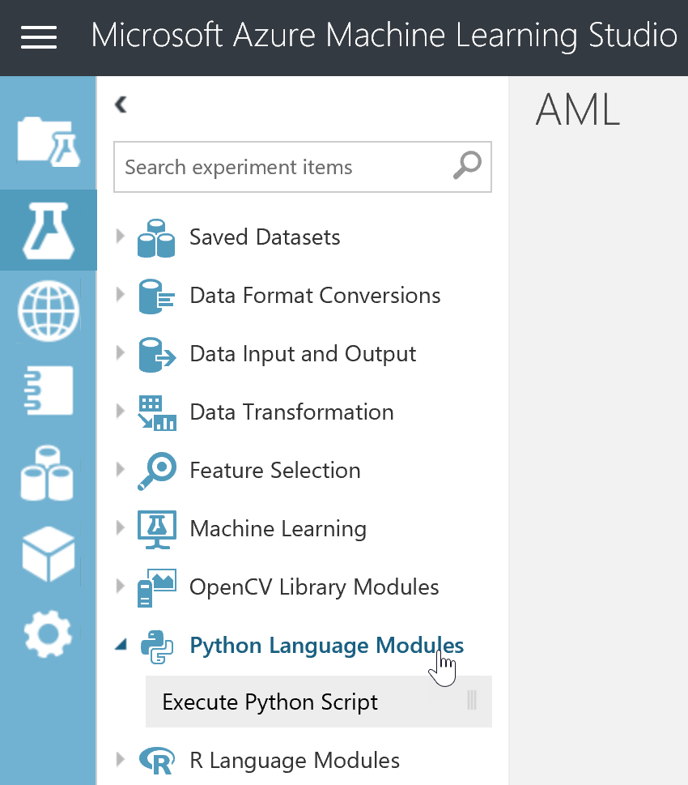
Python and Azure Machine Learning
Execute Python Script

Slide 57
MS & Python
Demo

Slide 58
Data Science
Demo

Slide 59
References
Python Docs
https://docs.python.org/3/reference/introduction.html
Coursera
https://www.coursera.org/specializations/python
MS Academy
https://academy.microsoft.com/en-us/professional-program/tracks/data-science/

Slide 60
References
The Hitchhiker’s Guide to Python!
http://docs.python-guide.org/en/latest/
Code Academy
https://www.codecademy.com/en/tracks/python
Google
https://developers.google.com/edu/python/?hl=en

Slide 61
Jamey Johnston
@STATCowboy
jameyj@tamu.edu
Dr. Je’Anna Abbott
@STATWonderWoman
jabbott@uh.edu

